Slide 1
Cs-381 Software Engineering
Course Instructor: Dr. Shazia Arshad
Notes:
Welcome to all of you in this course. I am Dr. Shazia Arshad. I will be your instructor for this course.

Slide 2
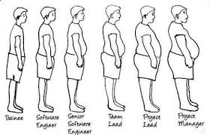
WATERFALL MODEL
Notes:
As you can see, a person at the beginning of his career cannot become project manager. For reaching at this stage, he has to gone through all the steps. This is completed phase wise. No step or phase can be missed.
And importantly, Can a person goes back from the position of Project Manager to Trainee???
Normally, this is NOT possible. Moving back and starting from first step is odd and very risky.
The steps which we have discussed previously are WATERFALL MODEL. It includes moving from phase to phase like next phase is started only when the previous phase is completed.
Similar, to the example given in slide, in waterfall model, one cannot skip a phase to move to the next step or cannot go back and start again.
As industries started to use this method, they ran into several issues. For example, they found that it's very difficult to predict the requirements one year or two years ahead, as the market changes, or sometimes it's just really difficult to predict what a user will like or not like.

Slide 3
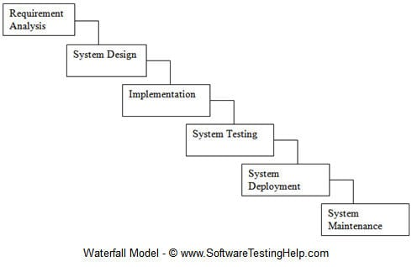
Phases of Waterfall model
Notes:
As I discussed in earlier slide that In waterfall model, development of one phase starts only when the previous phase is complete. Because of this nature, each phase of the waterfall model is quite precise and well defined.
In order to complete the project by using waterfall model method we follows these six steps.

Slide 4
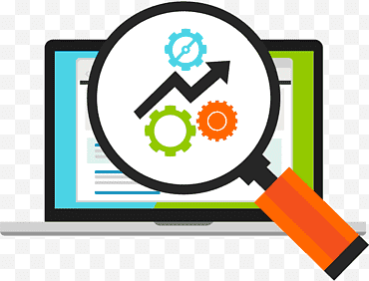
1. Requirement and Analysis
Notes:
Requirements Analysis is the process of defining the expectations of the users for an application that is to be built or modified. It involves all the tasks that are conducted to identify the needs of different stakeholders. Therefore requirements analysis means to analyze, document, validate and manage software or system requirements.
Requirement and analysis phases includes these things
1. Capture all the requirements. 2. Do brainstorming and walkthrough to understand the requirements. 3. Do the requirements feasibility test to ensure that the requirements are testable or not.
In software engineering we do documentation of each steps side by side, here after working on this requirement and analysis steps RUD ( Requirements Understanding Document) will comes as an output.

Slide 5
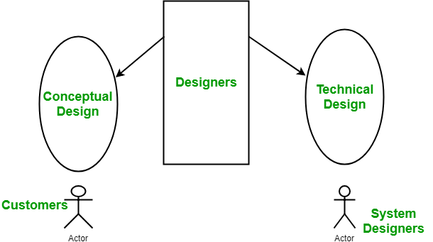
2. System design
Notes:
Systems design is the process of defining the architecture, modules, interfaces, and data for a system to satisfy specified requirements. Systems design could be seen as the application of systems theory to product development.
Daigram explains the brief points which involve in system design. In this phase we are focusing on these things
1. As per the requirements, create the design.
2. Capture the hardware / software requirements. 3. Document the designs
Output of this step results in two design documents.
HLD ( High Level Design document)
A high-level design document (HLDD) describes the architecture used in the development of a particular software product. It usually includes a diagram that depicts the envisioned structure of the software system. Since this is a high-level document, non-technical language is often used. LLD (Low level design document)
The goal of LLD or a low-level design document (LLDD) is to give the internal logical design of the actual program code. Low-level design is created based on the high-level design. LLD describes the class diagrams with the methods and relations between classes and program specs

Slide 6

3.Implementation
Notes:
Here the next phase is implementation. Coding takes place in this phase. With inputs from the system design, the system is first developed in small programs called units, which are integrated in the next phase. Each unit is developed and tested for its functionality, which is referred to as Unit testing.
These steps take place in this phase 1. As per the design create the programs / code 2. Integrate the codes for the next phase. 3. Unit testing of the code
The output of this phase is Programs Unit test cases and results.

Slide 7
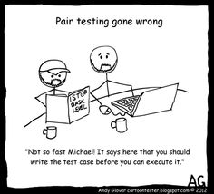
4.System testing
Notes:
In this picture, it is said that " Not so fast Michaell IT says here that you should write the test case before you can execute your program " which clearly shows the important of the testing phase that we should always test our code before deploying our project. If we do not do that we can face the bigger problem in future.
In this step, all the units developed in the implementation phase are integrated into a system after testing of each unit. Post integration the entire system is tested for any faults and failures.
This step return us Test cases, Test reports, Defect reports and the Updated matrices.

Slide 8
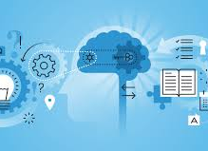
5.System deployment
Notes:
This picture shows the all 7 steps from gathering requirement to deployment. This shows that after completing all the steps we can finally launched our project or deploy to different systems.
In this phase, the software is deployed into a live environment (client’s server) in order to test its performance. Once the software deploy, it becomes available to end-users. Sometimes, this phase also includes training of real-time users to communicate benefits of the system.
The documentation part of this phase return us with User Manual, Environment definition / specification

Slide 9

6.System maintenance
Notes:
The final phase stage of the waterfall model is maintenance. When any new system is put in place it will often need ongoing maintenance. This is to make sure the software is operating at optimum levels of performance. This can be concerned with bugs in the software, security issues or to address issues that have only come to light when the new system was implemented. Activities in this phase include obtaining maintenance requests from the end users, transforming these requests into changes, designing the changes and finally implementing said changes.
There are four types of maintenance.
1. Corrective, which is concerned with removing errors or bugs from the software.
2. Adaptive, which is used to enhance the system by adding features, capabilities and functions as a result of new technologies.
3. Perfective, which improves the features of the system, usually done as a result of requests by the users of the system.
4. Preventative, which is concerned with the anticipation of problems and correcting them before they happen.
This phase can be significantly affected by each previous step in the model, for example, mistakes made during analysis and design can seriously hinder the success of the new system. Maintenance is then seen as a reactive step in which any errors are addressed so the system can operate effectively.
This phase return us with User Manual, List of production tickets, List of new features implemented.

Slide 10
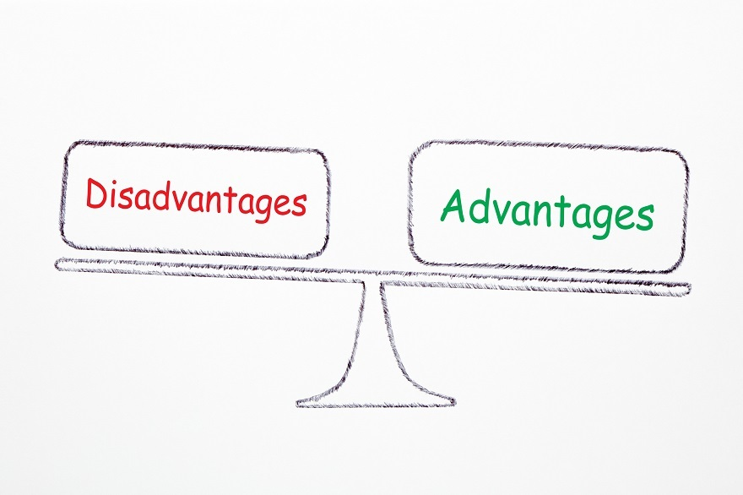
Advantages and disadvantages of waterfall model
Notes:
Advantages:
Simple and easy to understand and use.
For smaller projects, the waterfall model works well and yield the appropriate results.
Since the phases are rigid and precise, one phase is done one at a time, it is easy to maintain.
The entry and exit criteria are well defined, so it easy and systematic to proceed with quality.
Results are well documented.
Disadvantages:
Cannot adopt the changes in requirements
It becomes very difficult to move back to the phase. For example, if the application has now moved to the testing stage and there is a change in requirement, It becomes difficult to go back and change it.
Delivery of the final product is late as there is no prototype which is demonstrated intermediately.
For bigger and complex projects, this model is not good as a risk factor is higher.
Not suitable for the projects where requirements are changed frequently.
Does not work for long and ongoing projects.
Since the testing is done at a later stage, it does not allow identifying the challenges and risks in the earlier phase so the risk mitigation strategy is difficult to prepare.

Slide 11

Waterfall model is same as making of tea as once the process of making tea is done cannot be revert back.
CRM (Customer Relationship Management)
HRM (Human Resource Management)
Supply Chain Management System and Retail Chains
Point of Sale (POS)
Notes:
Examples of use waterfall model in real life projects
In the olden days, Waterfall model was used to develop enterprise applications like Customer Relationship Management (CRM) systems, Human Resource Management Systems (HRMS), Supply Chain Management Systems, Inventory Management Systems, Point of Sales (POS) systems for Retail chains etc.

Slide 12
Situations where waterfall model is Still Preferable Requirements are very well documented, clear and fixed.
Product definition is stable.
Technology is understood and is not dynamic.
There are no ambiguous requirements.
Ample resources with required expertise are available to support the product.
The project is short.
Notes:
There are some areas where Waterfall model was continued to be preferred.
Consider a system where human life is on the line, where a system failure could result in one or more deaths.
In some countries, such mishaps could lead to imprisonment for those who are accountable.
Consider a system where time and money were secondary considerations and human safety was first.

Slide 13

TIME TO THINK Discuss the limitations of Waterfall Model.
Notes:
So, its time to check if you are active or not???
So Discuss the limitations of Waterfall Model.

